Slide 1
Pls 2000 power & politics Dr. Shannon
Defining & Studying Politics

Slide 2
Defining & studying POLITICS
I. DEFINING POLITICS
II. STUDYING POLITICS
TERMS TO KNOW
Politics Normative analysis
Hypothesis Empirical analysis
Independent variable Dependent variable
Scientific Approach Anthropological Approach
Structured, focused comparison Critical Approach

Slide 3
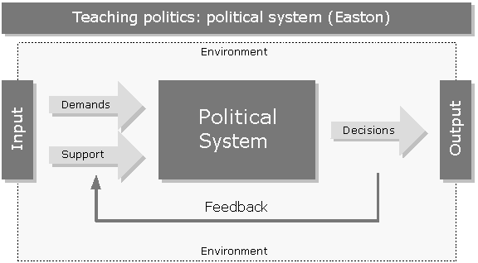
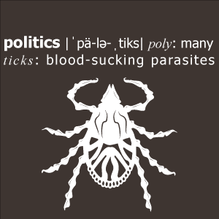
i. Defining politics
WHAT IS POLITICS? (P.2-5)
The process by which groups representing divergent interests & values make collective decisions under conditions of:
Diversity
Scarcity
Who gets what, when and how?
The authoritative allocation of values/resources (“mechanism whereby …goods can be distributed”)

Slide 4
political questions (Garner, pp.6-7)
What values should/do decision makers serve?
All
Themselves
Who should/does make decisions?
One
Few
Many
How are those making decisions able to enforce them?
Power (Coercion)
Authority (Legitimacy)

Slide 5
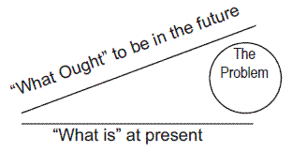
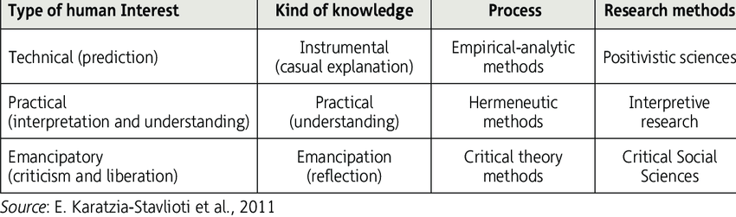
ii. studying POLITICS (pp. 12-20)
Normative v. Empirical Analysis:
Normative: what ought to be (identify what is good…recommending what we ought to want)
Empirical: what is (studying observable things to see how things really are; what is true)
Scientific Approach (uncover laws of cause and effect that explain patterns of political behavior across time and space)
Anthropological Approach (understand and interpret how others in a particular time and space see the world)
Critical Approach (“awaken” groups seen as repressed and “emancipate” them with theory and calls to action)
Can we study facts without values (objectivity)?
Are facts inevitable or can they be changed by values?
Notes:
Blue means not covered

Slide 6

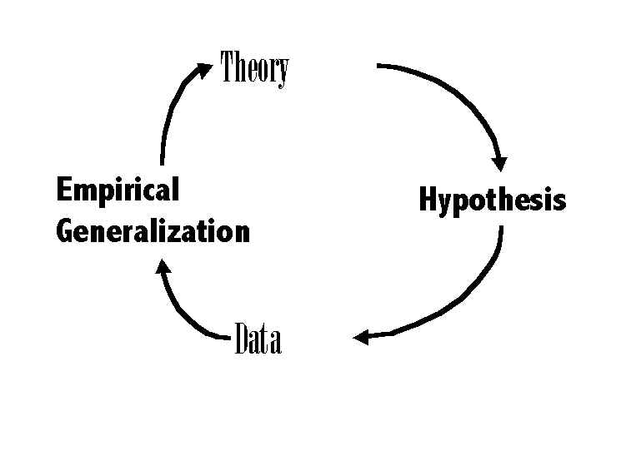
ii. studying POLITICS (pp. 12-20)
Empirical Theory: arguments about how and why political phenomena are causally related
Hypothesis: argument of causation arranged as independent variable (X) affecting dependent variable (Y)
Tested in observations of the real world
Parsimony: minimum factors explain maximum events
Generalizable: explanation applies beyond case to other like cases
Falsifiable: is the theoretical assertion capable of being tested and proven wrong? “Unfalsifiable” assertions can’t be proven or disproven

Slide 7
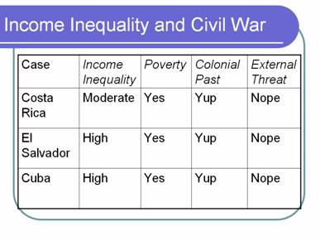
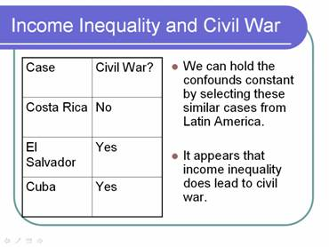
COMPARATIVE CASE STUDIES
Structured, Focused Comparison
Structure: Ask the same questions of both cases
Focus: Ask only questions relevant to your assignment and hypotheses
Notes:
Keep this slide in mind for the paper

